Slide 1
ASEAN UNIVERSITY NETWORK
established since 1995

Slide 2
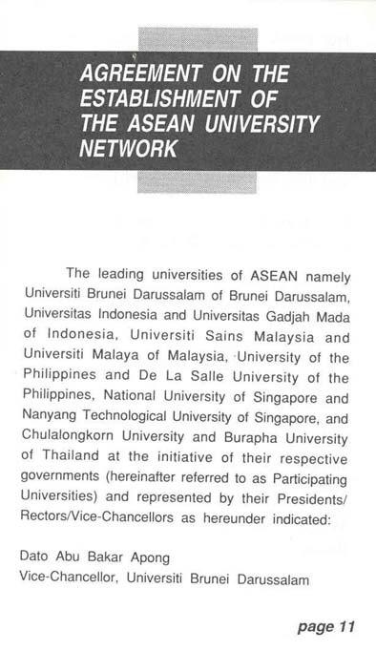
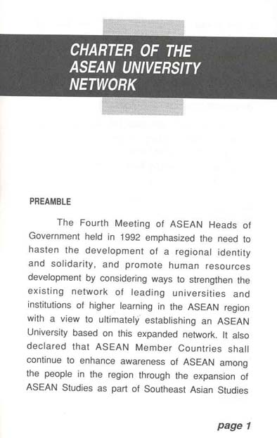
ASEAN University Network
1992 The 4th ASEAN Summit, the call for cooperation in the field of higher education and human resource development
1995 Charter of the ASEAN University
Network was signed by the ASEAN
Ministers responsible for higher
education.
Agreement on the Establishment
of the ASEAN University Network
was signed by the Presidents, Rectors and Vice-Chancellors of participating
universities.
2008 One of ASEAN Sectoral Ministerial Body

Slide 3
AUN in ASEAN Educational Cooperation
ASEAN Summit
ASEAN Education
Ministers Meeting
(ASED)
Southeast Asian Ministers of Education Organisation (SEAMEO)
ASEAN University Network (AUN)
ASEAN Senior Officials Meeting on Education (SOM-ED)
(ASEAN Sectoral Ministerial Body)

Slide 4
ASEAN University Network the Structure
AUN Secretariat Vision 2010 - 2014
To be an enabler of successful collective actions in the area of higher education within ASEAN and beyond.
To be the nexus of higher education institutions.
To continue to grow as a centre of networks, sub-networks and partnership building.
To direct attention to 3 key result areas in database, capacity building and collaborative research.
To focus on strategically-oriented approaches on AUN’s higher education policy activities.
Brunei Darussalam
Universiti Brunei Darussalam
Cambodia
Royal University of Phnom Penh
Royal University of Law and Economics
Indonesia
Universitas Gadjah Mada
Universitas Indonesia
Institut Teknologi Bandung
Universitas Airlangga
Lao PDR
National University of Laos
Malaysia
University of Malaya
Universiti Sains Malaysia
Universiti Kebangsaan Malaysia
Universiti Putra Malaysia
Myanmar
Institute of Economics, Yangon
University of Yangon
The Philippines
University of the Philippines
De La Salle University
Ateneo de Manila University
Singapore
National University of Singapore
Nanyang Technological University
Singapore Management University
Thailand
Chulalongkorn University
Burapha University
Mahidol University
Chiang Mai University
Viet Nam
Vietnam National University, Hanoi
Vietnam National University, Ho Chi Minh City
The AUN Board of Trustees, a policy body, comprises of:
10 representatives designated by the government of 10 ASEAN Countries;
The Secretary-General of ASEAN
The Secretary-General of the Office of the Commission on Higher Education, Thailand
The Chairman of Senior Official Meeting on Education (SOM-ED)
Director of Southeast Asian Ministers of Education Organisation (SEAMEO)
The Executive Director of AUN Secretariat
The BOT Meeting convene annually.
Policy level
AUN Board of Trustees
(AUN-BOT)
Coordinating / Monitoring Level
AUN Secretariat Strategies
AUN Secretariat
The 3Cs
Carry on
Champion
Create
The 3Ss
Strategise
Stimulate
Synergise
Implementing Level
26 AUN Member Universities
The 5Es
Economically Efficiently
Effectively Ethically
Environmental-friendly

Slide 5
AUN Thematic Networks
AUN Southeast Asia Engineering Education Development Network (AUN/SEED-Net) Secretariat: Chulalongkorn University
ASEAN Graduate Business and Economics Programme Network (AGBEP) Secretariat: De La Salle University
AUN Human Rights Education Network (AUN-HREN)
Secretariat: Mahidol University
AUN Inter-Library Online (AUNILO)
Secretariat: Universiti Sains Malaysia
ASEAN Credit Transfer System (ACTS)
Secretariat: Universitas Indonesia
AUN Intellectual Property (AUNIP)
Secretariat: Chulalongkorn University
AUN University Social Responsibility & Sustainability (AUN-USR&S)
Secretariat: Universiti Kabangsaan Malaysia
Welcome to join the thematic networks!!!

Slide 6
The Dialogue Partner Countries
CHINA
● ASEAN – China Academic Cooperation and Exchange Programme
JAPAN
● AUN/SEED-Net ● SEE Forum
Republic of Korea (ROK)
● ASEAN – ROK Academic Exchange Programme
● International College Student Exchange Programme
● Promotion of ASEAN and Korean Studies
EUROPEAN UNION (EU)
● CODOC ● ASEAN-QA (DIES Programme)
UNITED STATES
● ASEAN Studies Curriculum Design Workshop

Slide 7
AUN Landscape of Cooperation
AUN as a network of implementation for cross-regional cooperation
EU
ASEM
ASEAN
AUN
ASEAN+3
ASEAN+6

Slide 8
AUN’s Roles in ASEAN Higher Education Polices & Strategies
S&T Collaborative Research for Community Well-Being
Digital Contents Sharable
Quality Labour Force
ICT Competency
Knowledge-based Society
ASEAN Awareness
Cross-Sectoral Connectivity
Regional Academic Cooperation
Equal Access
Quality Standard
ASEAN Identity
East Asian Awareness

Slide 9
ASEAN University Network Composition & Activities
Policy-makers
(University’s Presidents/Rectors/VCs)
Academic Staff
ASEAN University Network
Our Stakeholders &
Our Key Result Areas
Other Stakeholders
Students

Slide 10
ASEAN University Network Composition & Activities
ASED Meeting
ASEAN
Policy Support
SOM-ED Meeting
AUN Rectors’ Meeting
AUN Rectors’ Conference
Policy-makers
(University’s Presidents/Rectors/VCs)
Policy Dialogue
ASEAN-China Rectors’ Conference
ASEAN+3 Rectors’ Conference
ASEM Rectors’ Conference
Programme Assessment
Policy Implementation
AUN-QA
Policy-makers
(University’s Presidents/Rectors/VCs)
Training the QA Experts for CLMV
ASEAN Credit Transfer System (ACTS)
Training
the AUN-Assessors
Academic Staff
Policy-makers
(University’s Presidents/Rectors/VCs)
ASEAN University Network
Stakeholders & Key Result Areas
Training
For Non-AUN Members
Other Stakeholders
Students

Slide 11
Southeast Asia Engineering Education Development Network
(AUN/SEED-Net)
AUN/SEED-Net
KASEAS
Collaborative Research
ASEAN-Korea Academic Cooperation (KASEAS)
ASEAN Graduate Business and Economic Programme (AGBEP)
Academic Exchange & Networking/ Sub-Networks
Sustainable Energy and Environmental Forum (SEE Forum)
Academic Cooperation (Conference, workshop, seminar, meeting, etc.)
Non-academic Networking
AUN Intellectual Property Network
(AUNIP)
AUN Human Right Network
(AUN-HREN)
ASEAN+3 IRO Meeting
AUN Inter Library Online
(AUNILO)
USR&S Workshop
Master Programme (UM)
ASEAN Studies
PhD Programme
IP Education (ECAP III)
Curriculum & Programme Development / Implementation
Academic Staff
Foundation Courses
(EWC, USA)
Human Right Education
Network of East Asian Studies (NEAS)
Foundation Courses
IP Law Programme
AUN/SEED-Net
IP Management & IP Law
IP Management Programme
Training lecturers
Human
ASEAN Studies
Resource Development
QA Officers
AUNILO
Non-human
Academic Staff
Academic Staff
Policy-makers
(University’s Presidents/Rectors/VCs)
Database of ASEAN Experts
ASEAN University Network
Stakeholders & Key Result Areas
ASEAN University Network Composition & Activities
Other Stakeholders
Students

Slide 12
Academic Staff
Policy-makers
(University’s Presidents/Rectors/VCs)
ASEAN University Network
Stakeholders & Key Result Areas
AUN Study Awards
Students
Student Exchanges
Other Stakeholders
Students
ASEAN Studies Scholarships
Scholarships
Student Mobility
China-AUN Scholarships
AUN Internship
International College Student Exchange (ROK)
Korean Studies Scholarships
GIST Scholarships (ROK)
Students
AUN/SEED-Net Scholarships (Japan)
AUN Educational Forum and
Young Speaker Contest
ASEAN Youth Cultural Forum
ASEAN University Youth Summit 2008/2009
Student Activities / Networking
Japan-ASEAN Student Conference (JENESYS)
Student Representatives’ Conference
ASEAN-Korea Youth Activities
ASEAN University Network Composition & Activities

Slide 13
SEAMEO
Academic Staff
Policy-makers
(University’s Presidents/Rectors/VCs)
Other Stakeholders
ASEAN University Network
Stakeholders & Key Result Areas
European University Association (EUA)
Other Stakeholders
Students
Partner Organisations
ASEAN Foundation
Japan Foundation
DAAD, HRK
Other Stakeholders
CHINA
Asia –Europe Foundation
JAPAN
Dialogue Partner Countries
ROK
EU
USA
AUN Composition & Activities

Slide 14
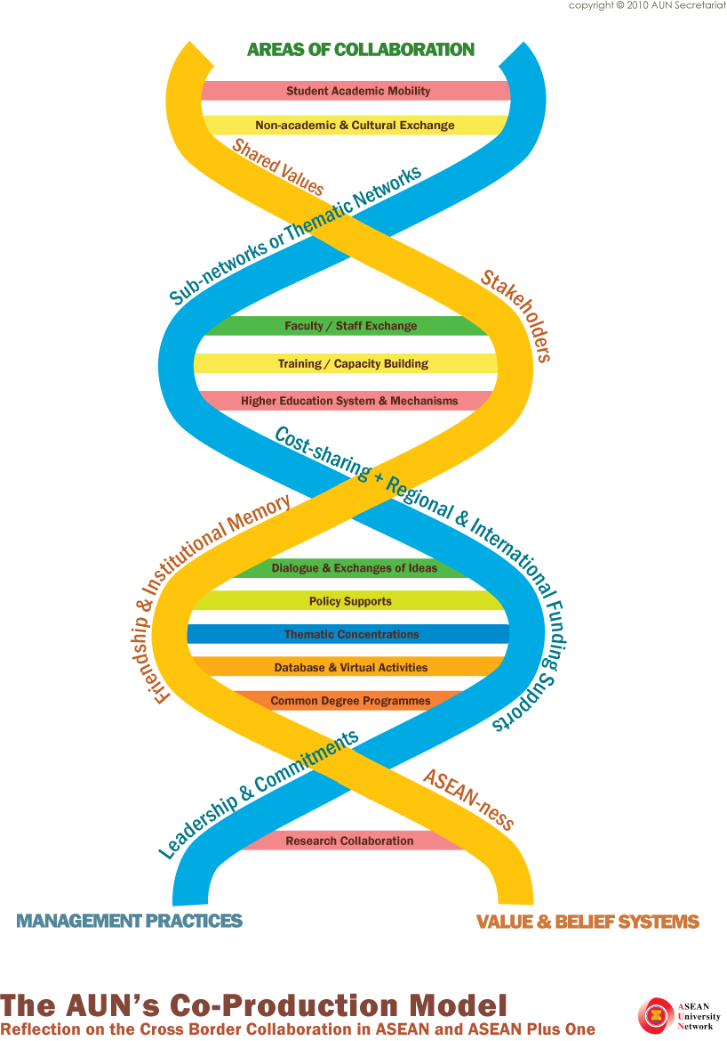
ASEAN University Network Co-Production Model
Management Practices
playing crucial roles in delivering concrete outcomes and sustainability of the network
Unique Value & Belief Systems which help facilitate the progress and engage all stakeholders

Slide 15
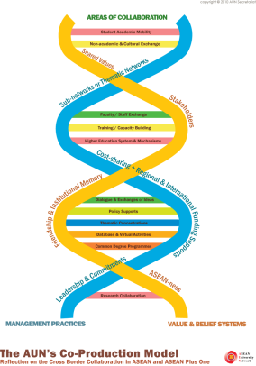
ASEAN University Network Co-Production Model
Shared Values
Roles of AUN in raising regional identity
Cross cultural realisation
Spirit of ASEAN
Good practices
Stakeholders
26 Member Universities
Board Members
Academician and experts
Dialogue partners (higher education institutions, public and private sector)
Students
Friendship & Institutional Memory
Close-knit community between rectors, presidents, VCs
“Grow together”
AUN branding
ASEAN-ness
ASEAN Sectoral Body
ASEAN Cooperation
ASEAN Citizenship
ASEAN Charter

Slide 16
ASEAN University Network Co-Production Model
Sub-Networks or
Thematic Networks
Area of mutual interest
Catalyst for initiatives and changes
Promote new ideas e.g. USR&S, IP, environmental, creative economy
Mechanism of activities
Qualification framework, quality assurance
ASEAN credit transfer as a mechanism
Cost-sharing + Regional Funding Support
Cooperation and contribution from AUN Member Universities
Financial and technical assistance
Royal Thai government in providing operation cost for AUN Secretariat
Leadership & Commitments
Consultation and consensus in area of mutual interest
Organisation (autonomy & capability)
AUN (Executive Director and Secretariat)

Slide 17
ASEAN University Network Co-Production Model
Student Academic Mobility
Non-academic & Cultural Exchange
Faculty/Staff Exchange
Training Capacity Building
Higher Education System & Mechanisms
Dialogue & Exchange of Ideas
Policy Supports
Thematic Concentrations
Database & Virtual Activities
Common Degree Programmes
Research Collaboration

Slide 18
The Contributions from our Stakeholders
Resource persons
Participations
Knowledge transfer
Exchanging of Ideas
Good practices
AUN Member Universities
Members of Thematic Networks
Students
AUN Member Universities
Members of Thematic Networks
Other stakeholders
Financial support
Cost-sharing
University’s policy support
AUN Member Universities
Members of Thematic Networks
Other stakeholders and partners
AUN Board of Trustees
Etc.

Slide 19
AUN towards ASEAN COMMUNITY
ASEAN Community
Socio-Cultural Community
Political Community
Economic Community
Invest in People
Narrow digital divide
Promote deeper regional awareness
Narrow
development gap
AUN
Policy Level
AUN
Student Exchange
China-AUN
Scholarship
ACTS
AUN-QA
AUNIP
IAI
Initiative for ASEAN Integration
Distinguished Scholar Programme
Collaborative Research
AUNILO
AUN-HREN
AUN/SEED-Net
Special
Taskforce
Education Forum &
Young Speaker Contest
ASEAN Youth Cultural Forum
Academic
Conference
International College Student Programme
ASEAN Studies
AGBEP
AUN
With strong concrete foundation, we shall never stop serving our stakeholders and help building a strong ASEAN Community
est. since 1995

Slide 20
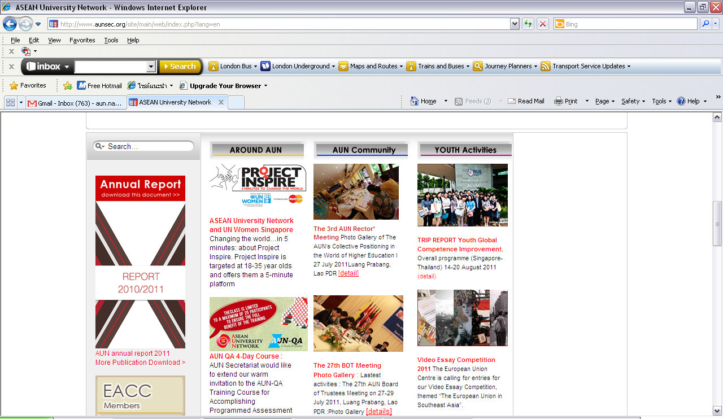
For more information
<www.aunsec.org>

